Slide 1




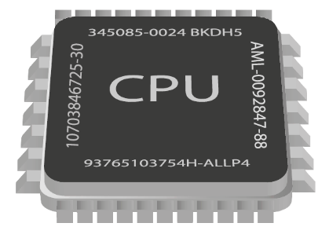
Asynchronous Programming
Writing Concurrent Code in C#
C#
Advanced
SoftUni Team
Technical Trainers
Software University
http://softuni.bg

Slide 2

Table of Contents
Synchronous vs Asynchronous Programming
Benefits and Drawbacks
Threads in C#
Tasks in C#
What are Tasks?
async and await
OS Level Concurrency

Slide 3

Synchronous Programming

Slide 4
Synchronous Programming
Executing program components sequentially
i.e. "Sequential programming"
Actions happen one after another
Uses a single thread of a single process
Components wait for previous components to finish
Program resources are accessible at all points

Slide 5
Synchronous Code
Synchronous code is executed step by step
10 static void Main()
11 {
12 int n = int.Parse(Console.ReadLine());
13 PrintNumbersInRange(0, 10);
14 Console.WriteLine("Done.");
15 }
16
17 static void PrintNumbersInRange(int a, int b)
18 {
19 for (int i = a; i <= b; i++)
20 {
21 Console.WriteLine(i);
22 }
23 }
int n = int.Parse(..)
PrintNumbersInRange()
Console.WriteLine(..)
...

Slide 6
Synchronous Programming Drawbacks
If one component is blocked, the entire program is blocked
UI may become unresponsive
No utilization of multi-core systems
CPU-demanding tasks delay execution of all other tasks
Accessing resources blocks entire program
Especially problematic with web resources

Slide 7
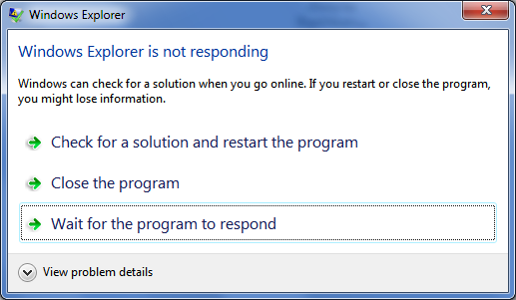
Synchronous Code
Live Demo

Slide 8
Asynchronous Code
Asynchronous programming allows the execution of code in the background
static void Main()
{
int n = int.Parse(Console.ReadLine());
PrintNumbersInRange(0, 10);
var task = Task.Run(() =>
PrintNumbersInRange(10, 20));
Console.WriteLine("Done.");
task.Wait();
}
int n = int.Parse(..)
for (0..10)
Console.WriteLine(..)
for (10..20)
Wait()

Slide 9
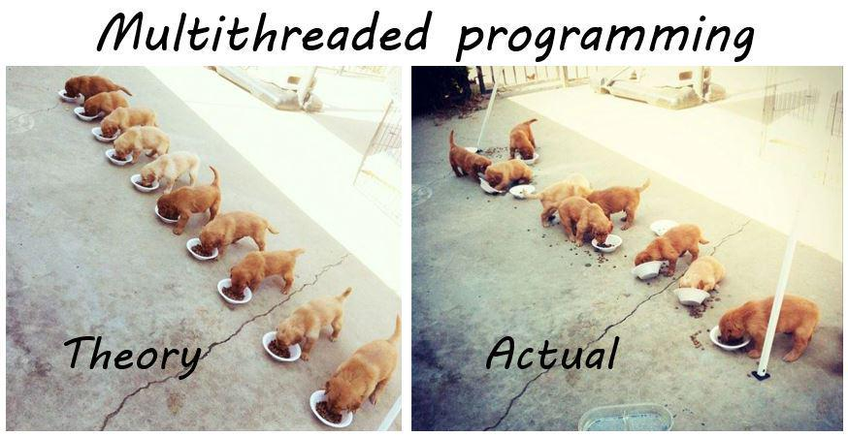
Threads

Slide 10

Threads
A thread is a fundamental unit of code execution
Commonly, programs use more than one thread
In .NET, there is always more than one thread
Each thread has a memory area associated with it known as a stack
Stores local variables
Stores the currently invoked methods in order of invocation

Slide 11
Threads in C#
Threads in C# can be created using the System.Thread class
Constructor accepts a method (delegate) to execute on a separate thread
Thread thread = new Thread(() =>
{
for (int i = 0; i < 10; i++)
{
Console.WriteLine(i);
}
});
thread.Start();

Slide 12
System.Thread
Start() – schedules the thread for execution
Join() – waits for the thread to finish its work (blocks the calling thread)
static void Main()
{
Thread primesThread = new Thread(() => PrintPrimesInRange(10, 100000));
primesThread.Start();
// Do something else
Console.WriteLine("Waiting for thread to finish work...");
primesThread.Join();
}

Slide 13
Thread – Example
static void Main()
{
Thread primesThread = new Thread(() => PrintPrimesInRange(10, 100000));
primesThread.Start();
Console.WriteLine("What should I do while we wait?");
while (true)
{
string command = Console.ReadLine();
if (command == "exit")
{
break;
}
}
primesThread.Join();
}
Console interface
remains unblocked

Slide 14
Thread Stack
Each thread has its own stack
The start (bottom) of the stack is the method from which the thread began execution
Each method (frame) stores local variables
...
IsPrime()
PrintAllPrimes()
Main()
...
IsValidUrl
DownloadAsync
background thread
main thread

Slide 15

Threads
Live Demo

Slide 16


Tasks in C#
Task Parallel Library

Slide 17
Tasks in C#
A task is a high-level representation of concurrent work
Does not block the main thread
May not run on a new thread (the CLR decides)
Offers several operations
Creating, running and returning result
Continuing another task (chaining several operations)
Proper exception handling
Progress/state reports

Slide 18
Creating Tasks in C#
Creating tasks can be done in several ways
Initialize a new Task object
Task.Run()
Task.Factory.StartNew() – enables additional task customization
Task task = new Task(() => { Console.WriteLine(""); });
Task.Run(() => TraverseMatrix());
Task.Factory.StartNew(() => CopyFileContents("got-s03ep1.avi"),
TaskCreationOptions.LongRunning);

Slide 19
Task API in C# – Example
static void Main()
{
SliceAsync("movie.avi", "Pieces", 5);
Console.WriteLine("Anything else?");
while (true)
{
Console.ReadLine();
}
}
static void SliceAsync(string sourceFile, string destinationPath, int parts)
{
Task.Run(() =>
{
Slice(sourceFile, destinationPath, parts);
});
}
Executes on another thread

Slide 20
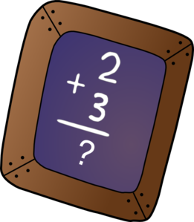
Primes Sum with Tasks
Live Demo

Slide 21

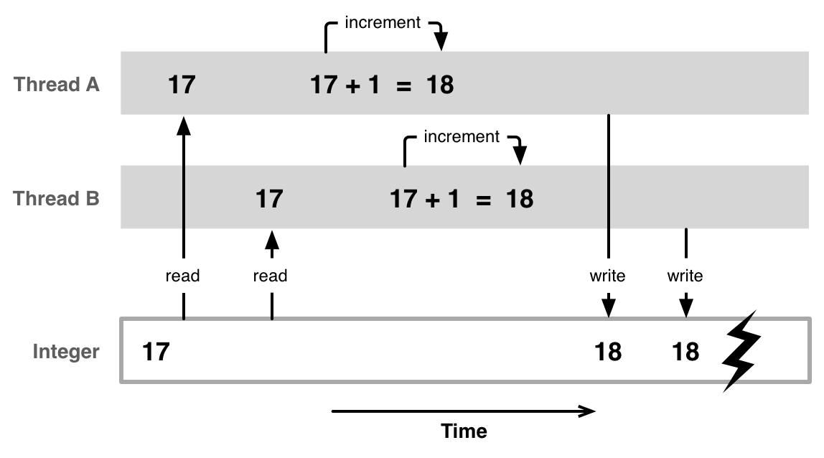
Race Conditions
A race condition occurs when two or more threads access shared data and they try to change it at the same time

Slide 22
Thread Race Conditions
A race condition occurs when two or more threads access shared data and they try to change it at the same time
List<int> numbers = Enumerable.Range(0, 10000).ToList();
for (int i = 0; i < 4; i++)
{
Task.Run(() =>
{
while (numbers.Count > 0)
{
int lastIndex = numbers.Count - 1;
numbers.RemoveAt(lastIndex);
}
});
}

Slide 23

Thread Safety – lock
A thread-safe resource can be safely accessed by multiple threads
lock keyword grants access to only one thread at a time and avoids race conditions
Blocks any other threads until the lock is released
lock (collection)
{
// code accessing shared resource // ...
}

Slide 24

Parallel Image Flips
Live Demo

Slide 25

Slicing Files with Tasks
Live Demo

Slide 26
Generic Tasks
Task<T> is a task that will return a result sometime in the future
Result blocks the calling thread until the task returns a result
Task<long> task = Task.Run<long>(() =>
{
var primes = PrimesInRange(0, 1000000);
return primes.Sum();
});
// ...
Console.WriteLine(task.Result);
Blocking operation

Slide 27

Tasks in C#
Live Demo

Slide 28
Tasks with async and await
The keywords async and await are always used together
async hints the compiler that the method might run in parallel
Does not make a method run asynchronously (await makes it)
Tells the compiler "this method could wait for a resource or operation"
If it starts waiting, return to the calling method
When the wait is over, execute the code after await
static async void SliceFileAsync(string file, int parts)

Slide 29
Tasks with async and await (2)
await is used in a method which has the async keyword
Saves the method state
Marks waiting for a resource (a task to complete)
Resource should be a Task<T>
Returns T result from Task<T> when it completes
await DownloadStringAsync("http://softuni.bg");
Returns Task<string>

Slide 30
async and await – Example
static void Main()
{
DownloadFileAsync(FileUrl, "book.pdf");
...
}
static async void DownloadFileAsync(string url, string fileName)
{
Console.WriteLine("Downloading...");
await Task.Run(() =>
{
using (WebClient client = new WebClient())
{
client.DownloadFile(url, fileName);
}
});
Console.WriteLine("Download successful.");
Process.Start(fileName);
}
The calling thread exits the method on await
Everything after that is executed on another thread

Slide 31
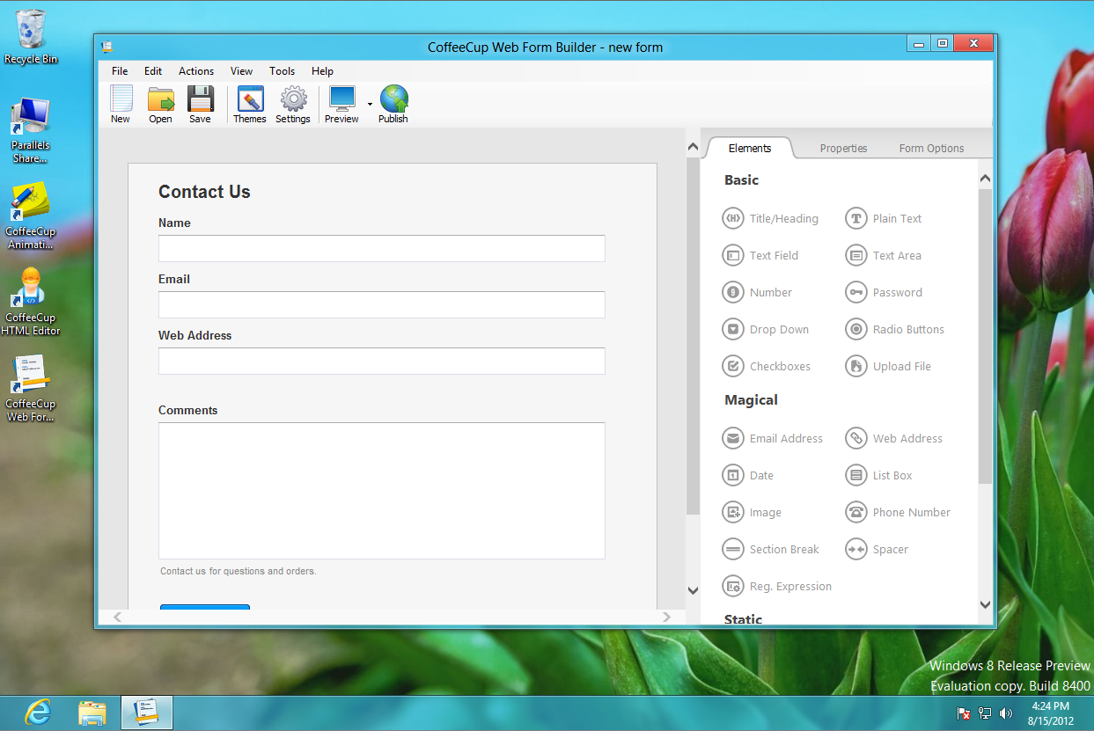
Graphical User Interface
Live Demo

Slide 32
Tasks with async and await
Live Demo

Slide 33
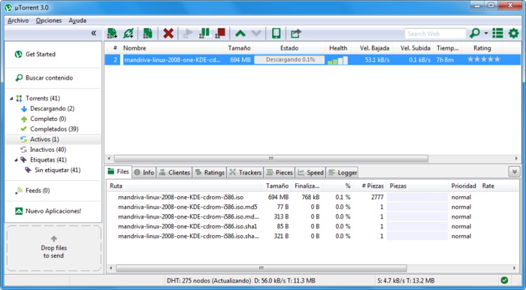
Asynchronous Programming – Benefits
If a component is blocked, other components still run
UI runs separately and always remains responsive
Utilization of multi-core systems
Each core executes one or more threads
CPU-demanding tasks run on "background" threads
Resource access runs on "background" threads

Slide 34
Asynchronous Programming – Drawbacks
Hard to know which code parts are running at a specific time
Harder than usual to debug
Have to protect resources
One thread uses a resource
Other threads must wait for the resource
Hard to synchronize resource access
Deadlocks can occur

Slide 35
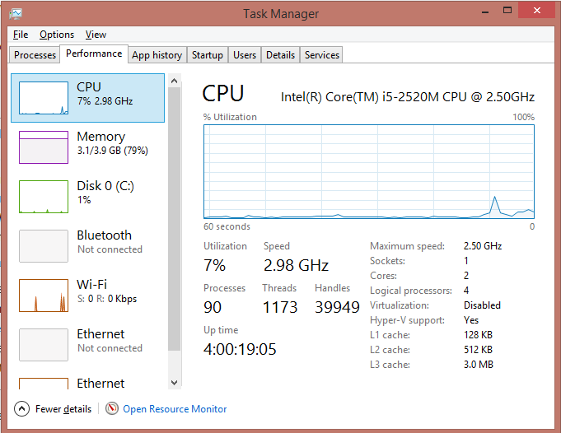
Operating System Concurrency

Slide 36
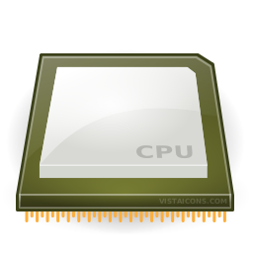
Instruction Execution
Each program's code is translated to CPU instructions
Program.cs
int a = 5;
int b = 4;
Console.WriteLine(a + b);
Compilation
Program.exe
Single-Core CPU
00DA2655 mov dword ptr [ebp-40h],5
00DA265C mov dword ptr [ebp-44h],4
00DA2663 mov ecx,dword ptr [ebp-40h]
00DA2666 add ecx,dword ptr [ebp-44h]
00DA2669 call 73B5A920
00DA266E nop
Instructions are executed one by one

Slide 37
Multi-Tasking
A computer can run many processes (applications) at once
But a CPU core can only execute one instruction at a time
Parellelism is achieved by the operating system's scheduler
Grants each thread a small interval of time to run
program.exe
chrome.exe
winamp.exe
system.exe
program.exe
...
0 10 20 30 40 50 ms

Slide 38

Helpful Resources
SoftUni Seminar on Concurrent C#
Article on Task API
Stephen Cleary Blog
https://softuni.bg/trainings/1021/Concurrent-Programming-in-C-Sharp
http://www.infoq.com/articles/Tasks-Async-Await
http://blog.stephencleary.com/

Slide 39
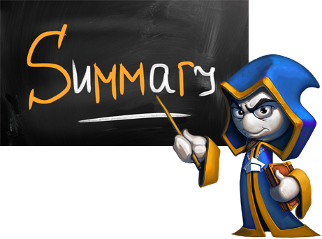
Summary
A thread executes code
Each thread has its own call stack
Multithreading means a program can do several
operations in parallel by using many threads
Used to offload CPU-demanding work so the main thread does not block
Can lead to synchronization issues and unexpected results
Tasks facilitate the work with threads
async and await keywords

Slide 40









Asynchronous Programming
https://softuni.bg/trainings/1361/advanced-c-sharp-may-2016

Slide 41

License
This course (slides, examples, demos, videos, homework, etc.) is licensed under the "Creative Commons Attribution-NonCommercial-ShareAlike 4.0 International" license
Attribution: this work may contain portions from
"C# Fundamentals – Part 2" course by Telerik Academy under CC-BY-NC-SA license

Slide 42






Free Trainings @ Software University
Software University Foundation – softuni.org
Software University – High-Quality Education, Profession and Job for Software Developers
softuni.bg
Software University @ Facebook
facebook.com/SoftwareUniversity
Software University @ YouTube
youtube.com/SoftwareUniversity
Software University Forums – forum.softuni.bg

